Slide 1

Website Development: Lesson 9
Facilitated by: Titus Kariuki
Notes:
Web development kahoot

Slide 3
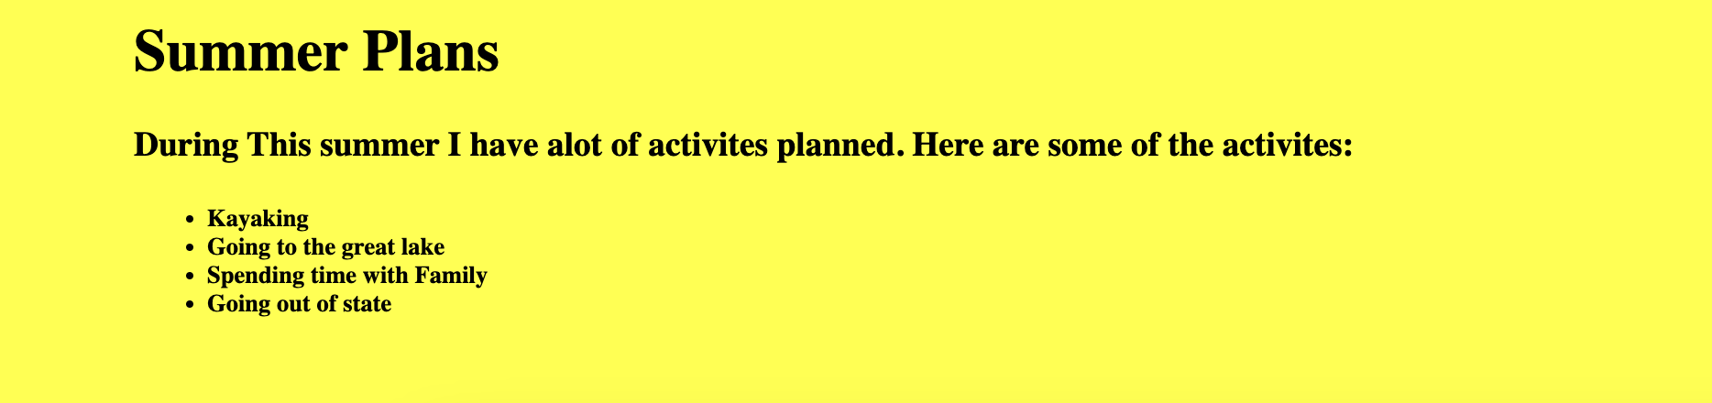

Slide 4
Agenda
1. Ice breaker
2. Recap
3. Introduction to Padding
5. Margins
6. Q&A & Exercises

Slide 5

Ice Breaker
One question you have about tech
How do you like the class?
How can we improve?

Slide 6
Recap
Last time we created a recipe book that used HTML and CSS
HTML tags
Jumping
Lists
Tables
CSS - colors, text design
Questions?

Slide 7
CSS Padding
What is CSS padding?
Padding = creating space in between your stuff

Slide 8
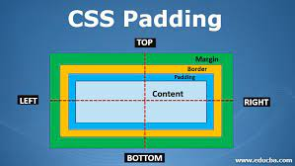
Intro to Padding
You use CSS for padding.
You can use pad if you want some background space around your element
You can pad the bottom, top, and sides of an element
We use pixels “px” to pad.

Slide 9
Intro to Padding
You can write the padding code in two ways:
Standard - the long way
Shorthand - a shortcut

Slide 10
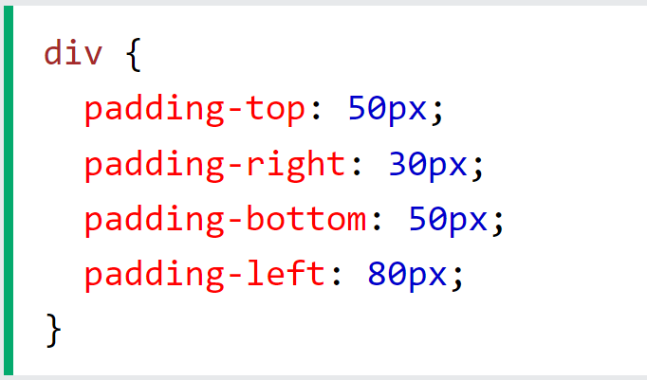
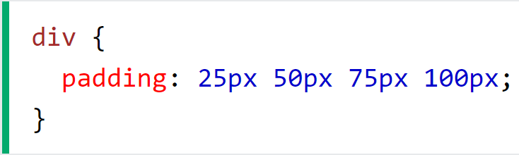
Intro to Padding
Standard Padding Code:
Fully write out each padding location and specify the size
Use this when you’re starting out so that you get used to it.
Shorthand Padding Code:
The computer recognizes padding as going from top, right, bottom, left
All you have to do is specify the numbers is a separated list
Don’t use if you’re not padding all sides

Slide 11
Div Class
What is the “div” tag?
div specifies a part of the HTML that will have some CSS style (like the “id” tags)

Slide 12
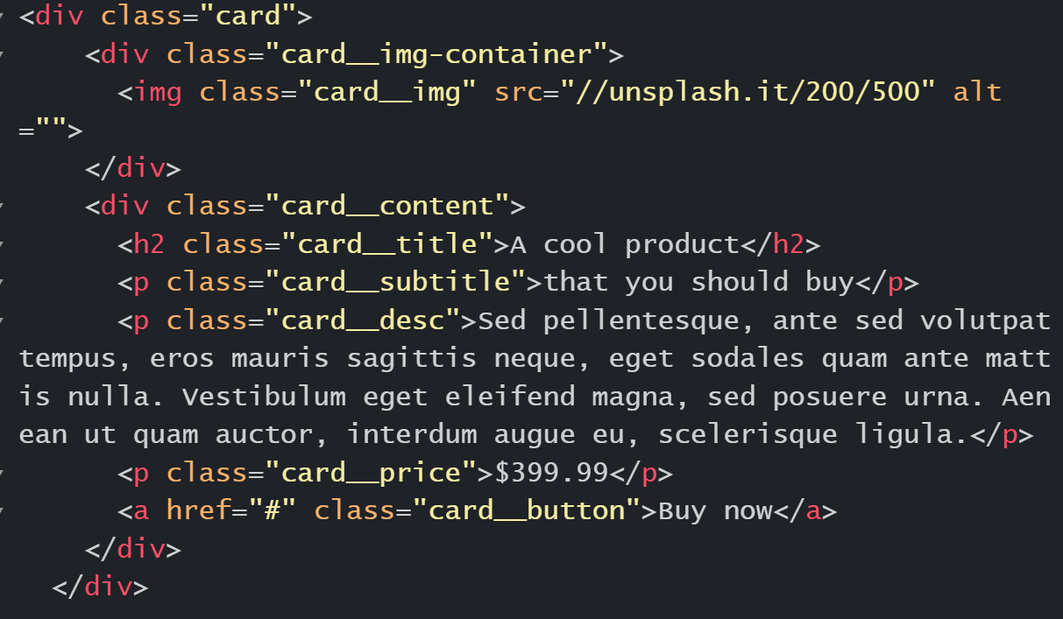
Div Class
What is the “div” tag?
Div creates a container that you can add more styles using class (div class=””)

Slide 13
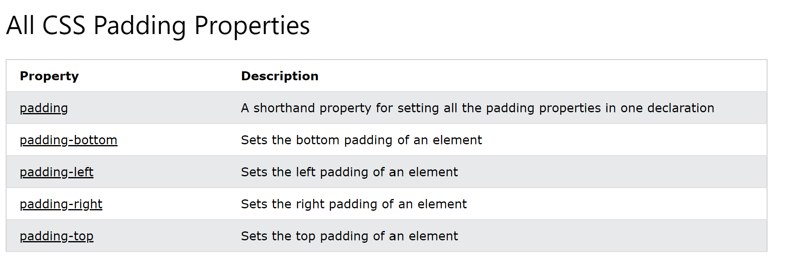
Div Class

Slide 14
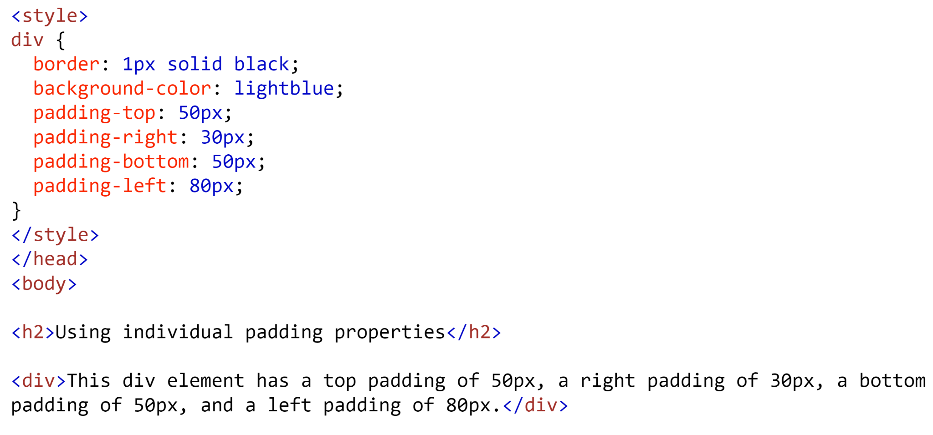
Padding Code
Try adding this code below:
Notes:
Full code: W3Schools Tryit Editor

Slide 15
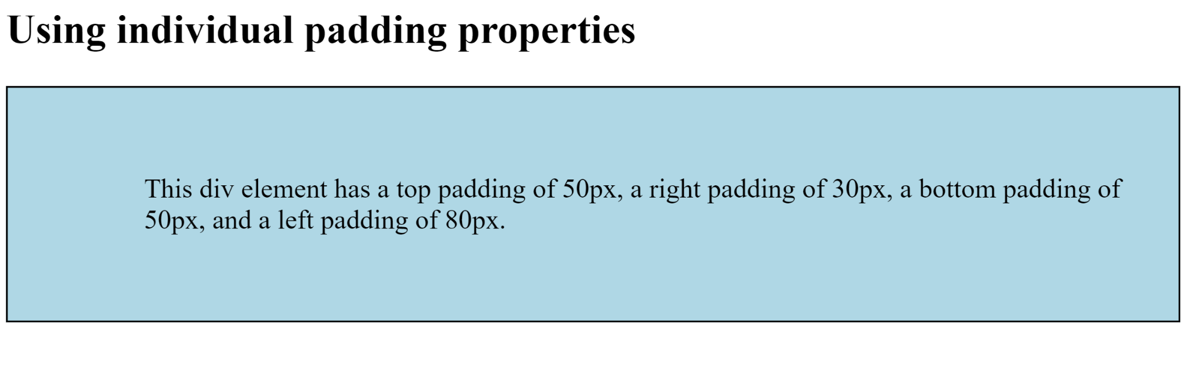
Padding Code
It should look like this:

Slide 16
Exercise: CSS Padding
We’ll now use CSS Padding to create…something.
Write about your Summer Plans, then decorate them using CSS Padding.
Note:
Use CSS Padding
(Optional) Use the <div> tag
It should look like something in the previous slide.
Notes:
Check the “Lesson 9 - Sample Padding Code” in the Drive for the full answer.

Slide 17

Questions?

Slide 18
Margins
What Are Margins?
Margins = spaces around elements
Just like yourself; think of the space around you as your margin.

Slide 19
Margins
Margins Vs. Padding
Margins are the space around an element
Padding is used to “pad” the space within an element
Margins are outside, padding is inside.

Slide 20
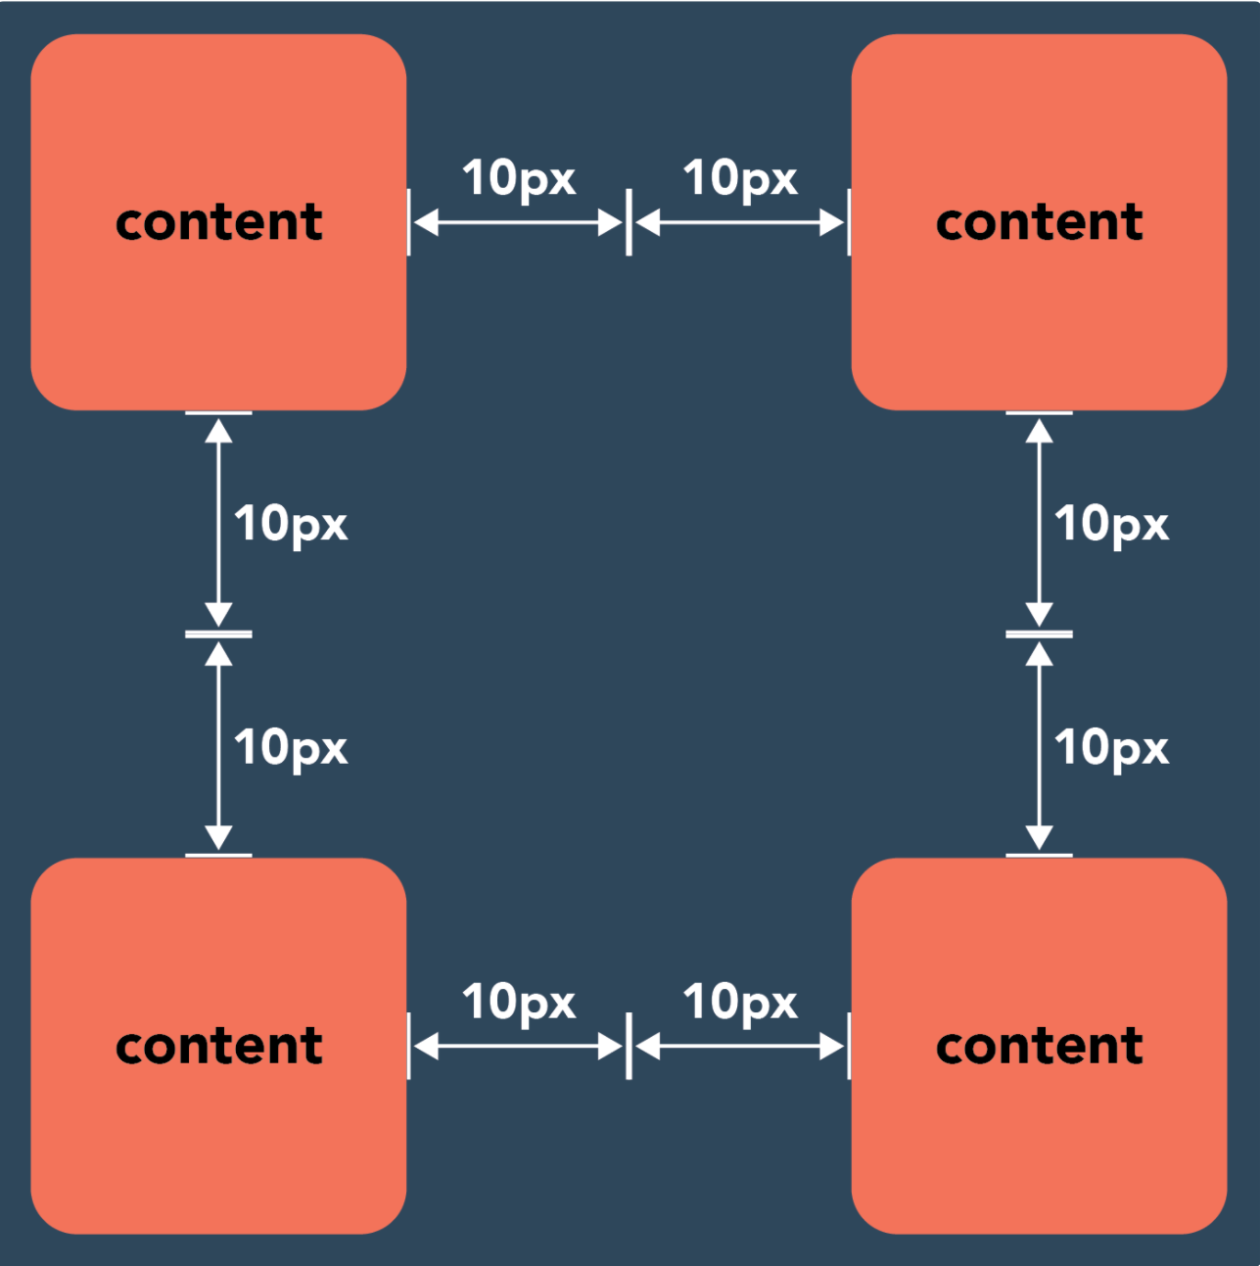
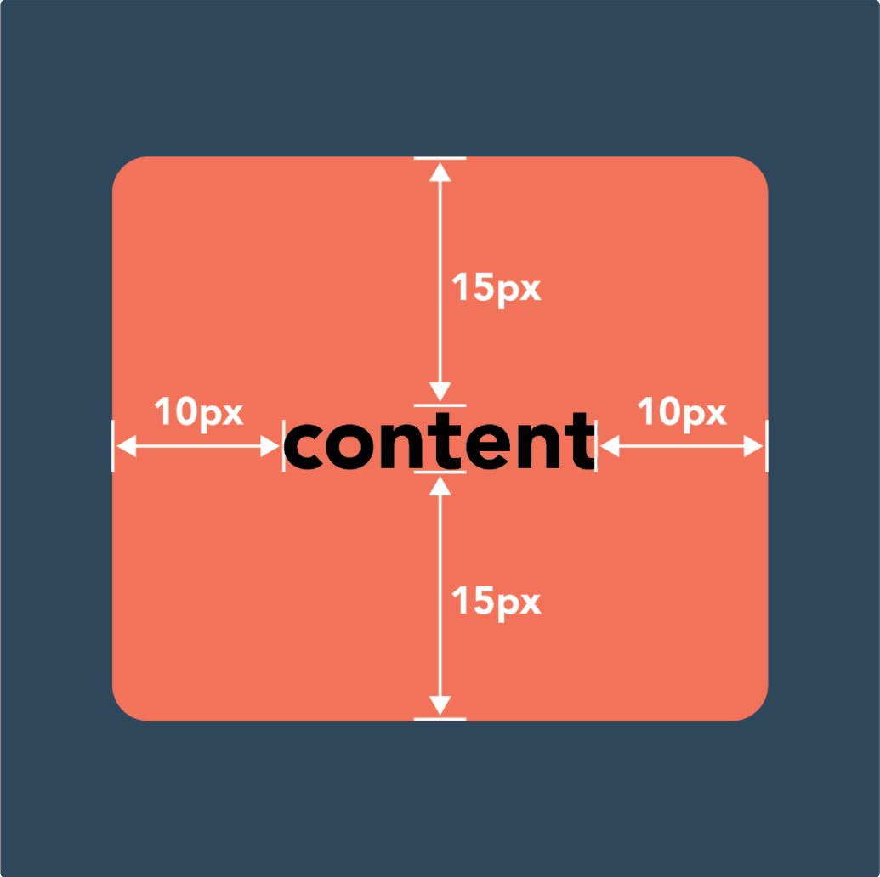
Margins
Margins Padding

Slide 21
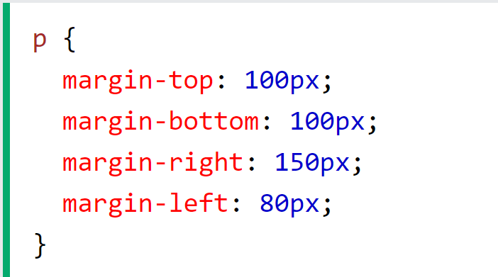
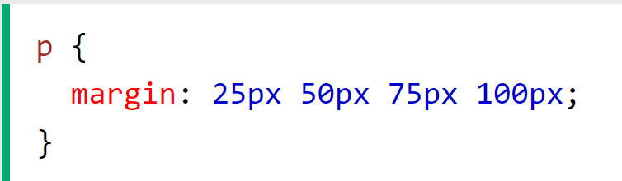
Margins
Just like padding, you can write margin code in either the standard or shorthand way
Again, shorthand goes top, right, bottom, left

Slide 22
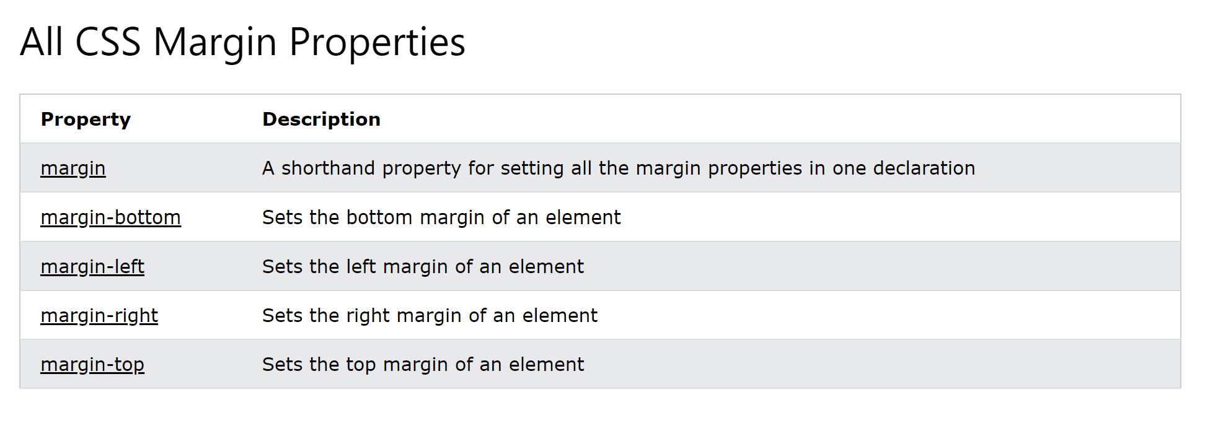
Margins
Notes:
OPTIONAL: W3Schools goes in depth on margins: CSS Margin (w3schools.com)

Slide 23
Questions?

Slide 24
Exercise: CSS Padding
We’ll now use CSS Padding to create…something.
Return to the code you just made on Summer Plans…and now add the margin code to the <div> tag
The instructors will show you how.
Notes:
Check the “Lesson 9 - Sample Padding & Margin Code,” under the “Padding & Margin Code” section for the full answer.

Slide 25
Questions?

